Slide 1

Changing Pattern and Unusual Presentation
Of
Dengue Syndrome
Professor Quazi Tarikul Islam
FCPS, FRCP(Edin. Glasg.), MACP
Professor of Medicine
Editor in Chief
National Guideline for Clinical management
of Dengue Syndrome 2018

Slide 2
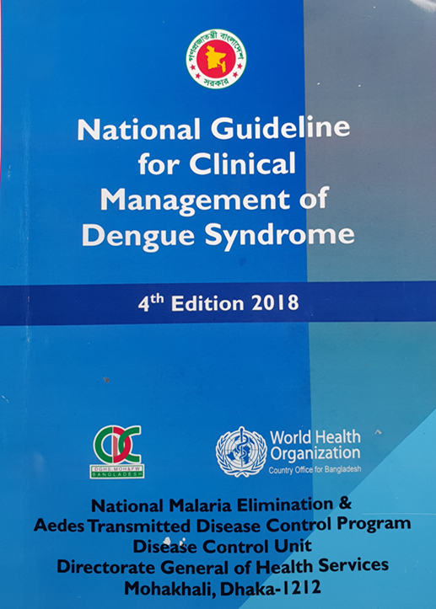
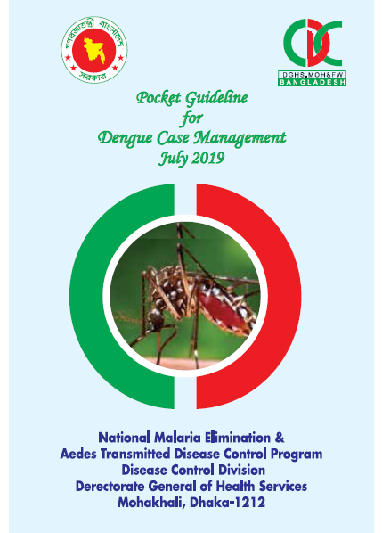
New guideline 2018
Pocket guideline 2019

Slide 3
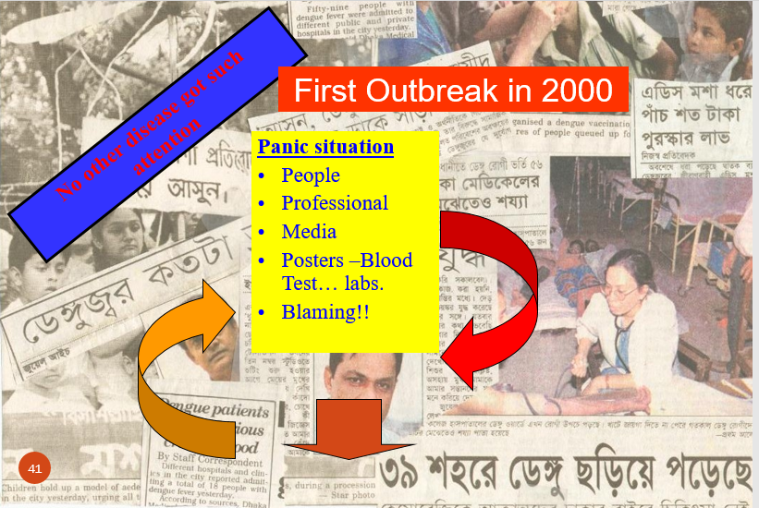

Slide 4
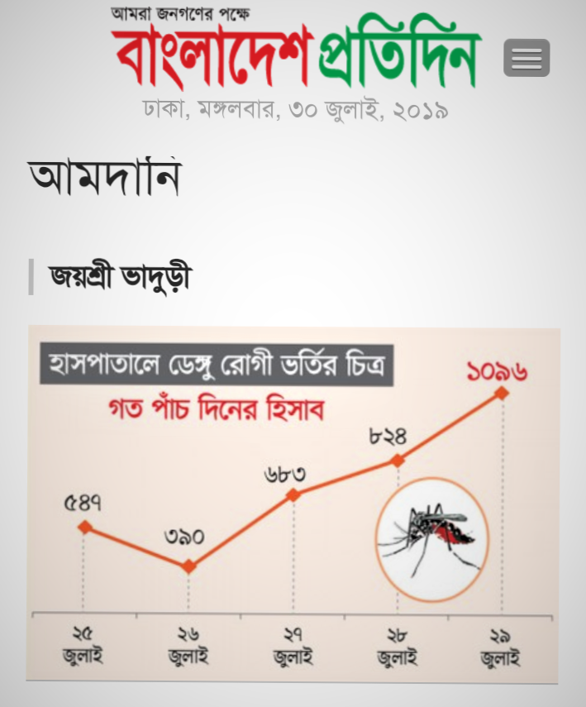
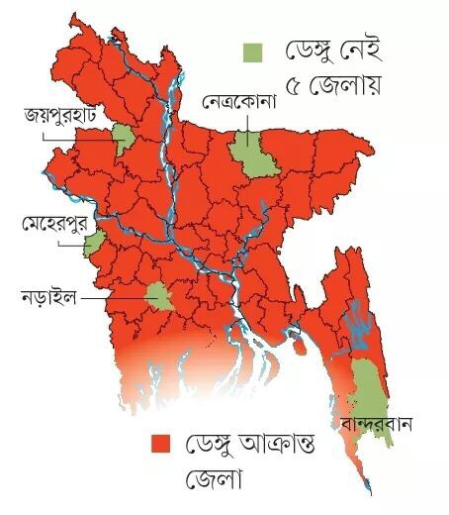

Slide 5
Clinical Picture of Dengue : South Asia (July & August, 2019)
Philippines : 130,463 cases, 561 deaths
Malaysia: 75,913 cases, 111 deaths
Vietnam : 115,186 cases, 12 deaths
Thailand: 44,671 cases, 62 deaths
Singapore: 8020 cases
Srilanka : 234,078 cases, 47 deaths
Source: CDC

Slide 6
The Philippines has declared in year 2019 a national Dengue epidemic after 622 deaths -- CNN

Slide 7
The spread of dengue has become a major public health concern in recent times due to alarming climate change.
Using country level panel data over the 2000–2017 period, it has been confirmed that climate change and socio-economic variables on the incidence of dengue-borne diseases in some of the most highly vulnerable countries.
Climate change is one of the worst global threats ever faced in human history.
Watts, N.; Adger, W.N.; Agnolucci, P.; Blackstock, J.; Byass, P.; Cai, W.; Grace, D.; Li, M.; Yu, C.; Yin, Y.; et al. Health and climate change: Policy responses to protect public health. Lancet 2015, 386, 1861–1914.

Slide 8


Slide 9
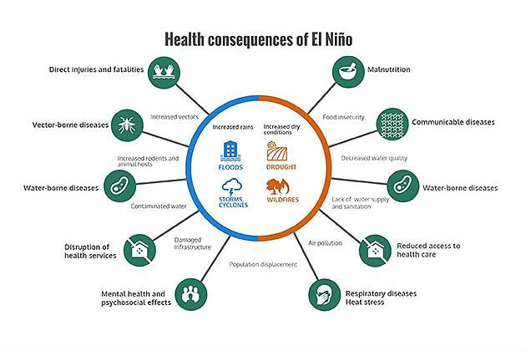

Slide 10

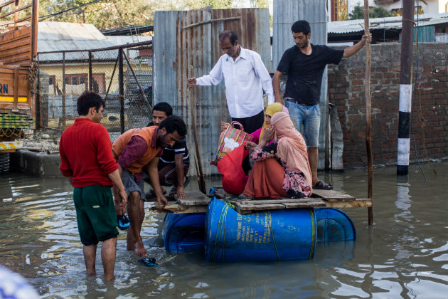
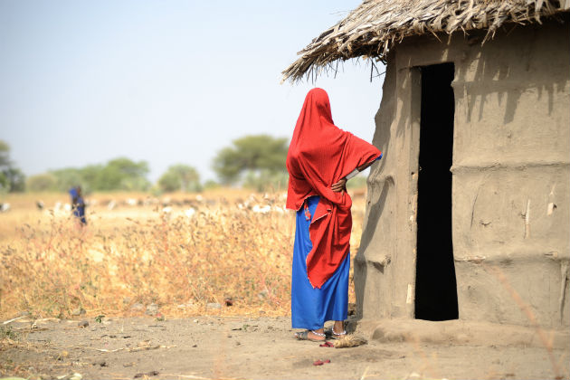

Slide 13
Prediction and Future
Future Epidemics
“We’re much better at predicting climate and weather than we are at predicting diseases. ”If the El Niño–dengue fever connection proves to be robust in some places, health officials could take extra cautionary measures whenever El Niño conditions began to build, such as readying hospitals for an influx of patients or improving mosquito control.
Hoping for “a regional, systematic process of disease monitoring and prediction, “we’re much better at predicting climate and weather than we are at predicting diseases. As there is link between El Nino and Dengue, climate data can really help us predict disease better.”
—JoAnna Wendel, Staff Writer

Slide 14
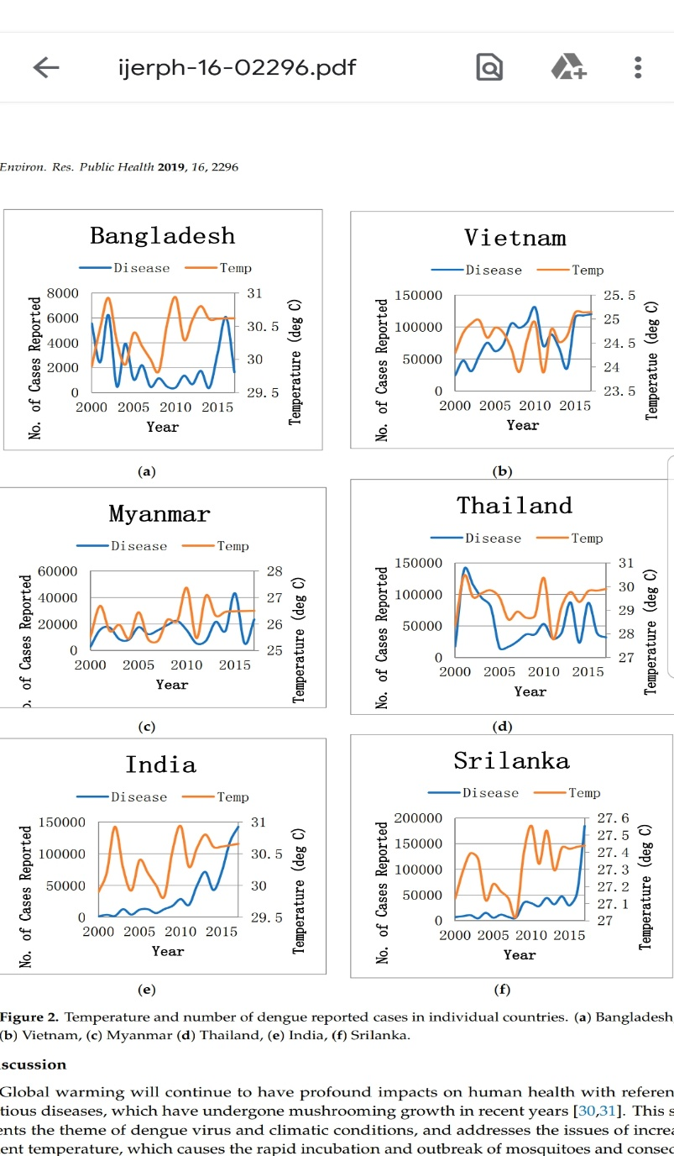
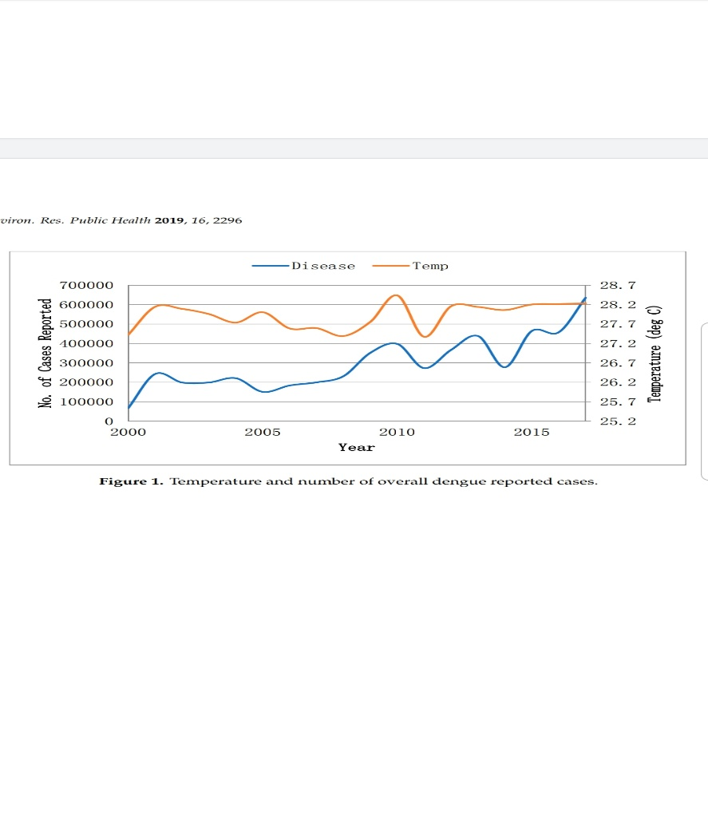
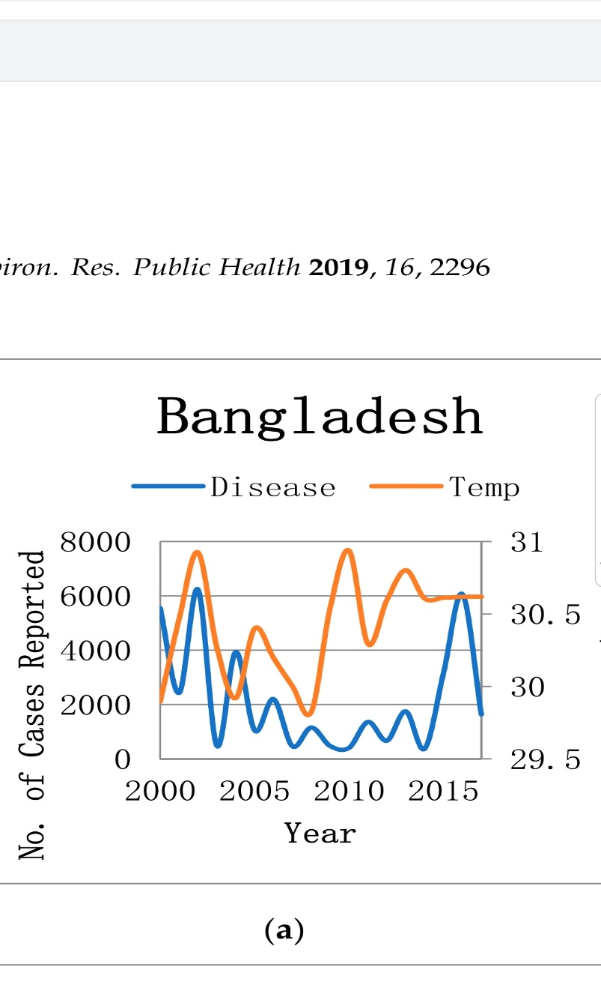
Int. J. Environ. Res. Public Health 2019, 16, 2296

Slide 16
Climate Change – El Nino
Dengue fever and dengue hemorrhagic fever is a mosquito-borne disease endemic to Southeast Asia. Despite intensive vector control efforts, large periodic dengue epidemics have continued to occur throughout the region in multi-annual cycles .
The El Niño-Southern Oscillation (ENSO), an ocean-atmosphere phenomenon of the Pacific Ocean with a semi-periodic multi-annual cycle , has been hypothesized to be a driving force behind the dengue epidemics in regions at risk through its profound influence on the local climate .
El Niño begins with a rise in surface seawater temperature over the tropical eastern Pacific Ocean that later extends as far as the western Pacific and has a warming effect on surface air .

Slide 17
Contd
Higher air temperature can facilitate the transmission of dengue by increasing the replication rate of the dengue virus in Aedes aegypti and the blood-feeding behavior of the mosquito vector.
Studies in the Pacific Islands, French Guiana, and Indonesia showed that El Niño was associated with an increase in annual numbers of reported dengue cases . A non stationary association between El Niño dynamics and monthly dengue hemorrhagic fever incidence was also shown in the Bangkok area of Thailand from 1986 to 1992 .

Slide 18
The presence of the EL-Nino leads to an increase in sea-surface temperatures. (ii) It weakens the trade winds in the regions and causes heavy rainfall, floods or droughts in different regions of the world.Mar 13, 2017
La Nina
ENSO

Slide 19
Dengue fever and dengue haemorrhagic fever epidemiological changes
Changes in human host :
A.Shift in affected-age group:
In South-East Asian countries, where all the serotypes (DENV-1-4) are circulating, DF is typically acknowledged to be a disease of early childhood, while clinical DF in adults was rare. DHF/DSS in these areas occurs mostly in children aged 2-15 years. Older and many of the younger inhabitants are usually immune and escape DHF, as they have acquired immunity against primary infection.
Bhatia R, Dash AP, Sunyoto T. Changing epidemiology of dengue in South-East Asia. WHO South-East Asia J Public Health 2013;2:23-7

Slide 20
However, there is an evidence of increase of dengue incidence in older age groups, and this age shift has been reported in Singapore, Indonesia, Bangladesh and Thailand
In Thailand, cases of DHF/DSS in small infants as young as 1-2 months and in adults have been reported with increasing frequency.
In Nepal, during the first-ever outbreak in 2010 (virgin soil), majority of the cases occurred between the age of 16 and 45 years.

Slide 21
In first DHF outbreak in Bangladesh, the age group of 18-33 years were the most affected.
Sri Lanka with chronological overview shows that modal age group affected by dengue has shifted from <15 years of age to 15-34 years of age.
In India, a legendary film maker died of DHF with multi-organ failure at the age of 80 years (Media Reports 21 October 2012) and older age group was significantly affected in the last major outbreaks in Delhi, India.

Slide 22
B. Sex differences
C. Rural expansion

Slide 24
700000
2000 2005 2010 2015
Temperature (deg C)
No. of Cases Reported
Year
Disease Temp

Slide 25
Dengue: Bangladesh (1 January to 16 September 2019)
Health Emergency operation centre, DGHS
People affected by dengue
Released from hospitals
81839
79129

Slide 26
Dengue: Bangladesh (1 January to 16 September) 2019
Official death
68
Unofficial death
203

Slide 27
Dengue Cases over Years
(Source: National guideline for Clinical management of Dengue syndrome)

Slide 28
Dengue Cases over Years
(Source: National guideline for Clinical management of Dengue syndrome)

Slide 29
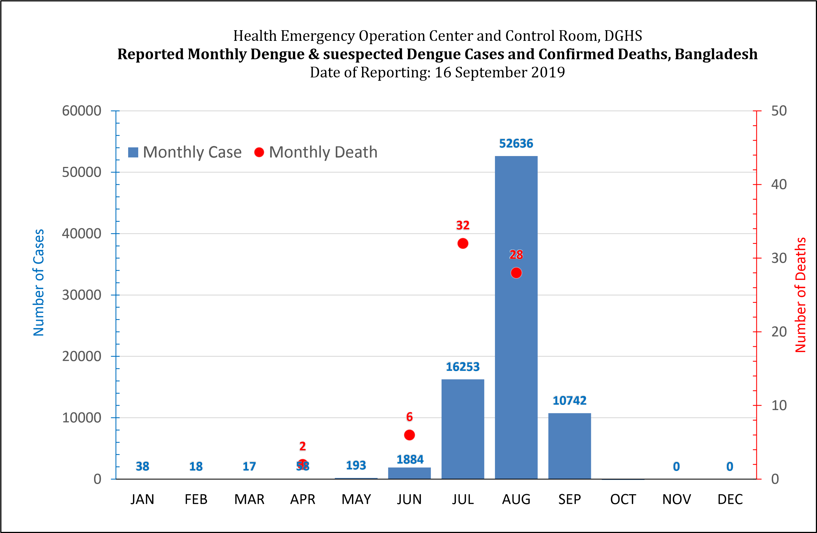

Slide 30
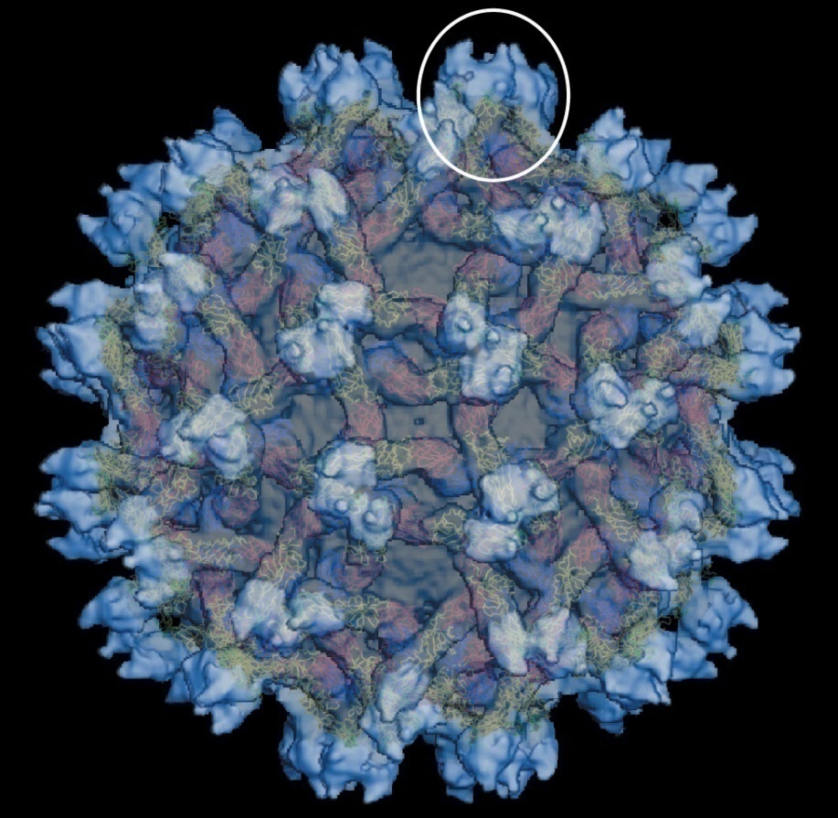
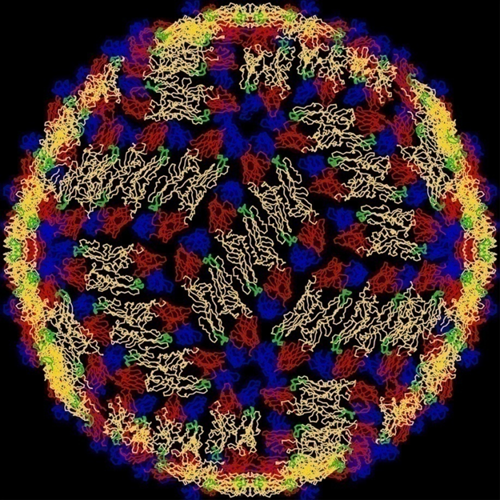
Responsible dengue viral particles

Slide 31
Tissue Tropism
In vitro many cell types like monocytes, epithelial cells, endothelial cells, hepatocytes, myocytes can be infected with DENV
Evidence of in vivo infection: presence of antigen, genome, active replication (negative viral RNA), in tissue samples

Slide 33
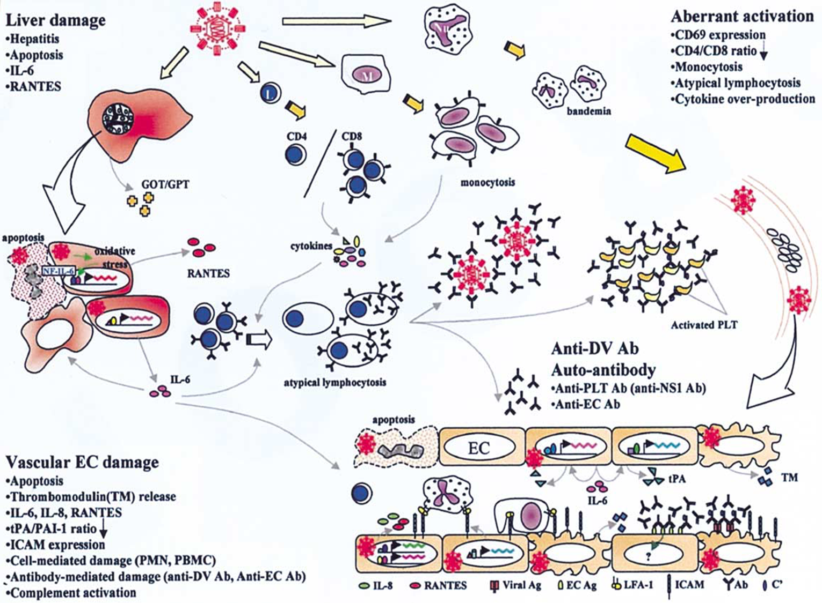

Slide 35
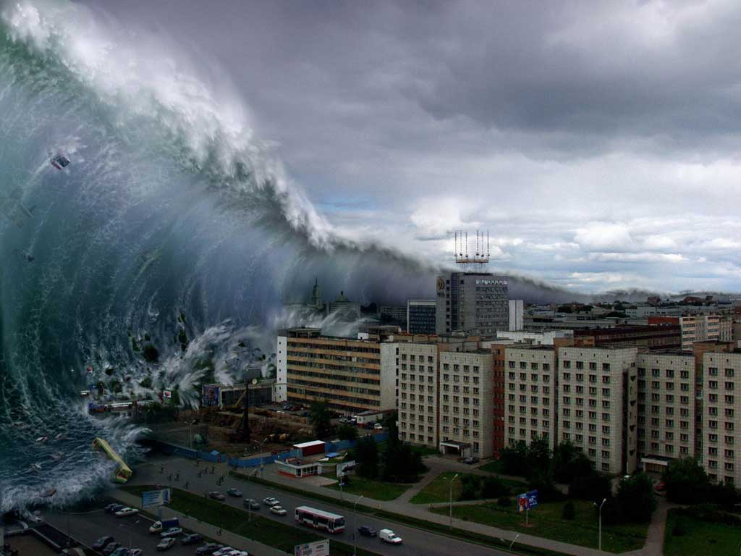

Slide 36
Why study pathogenesis?
To develop therapeutic interventions
To develop predictive indicators or profiles of severe disease
To identify protective and pathogenic immune correlates

Slide 37
Evidence of Plasma leakage
Haematocrit (HCT) – Rising HCT, A 20% rise of HCT from the baseline is indicative of significant plasma leakage
Plasma leakage is due to increased capillary permeability
Plasma leakage in DHF is selective and transient and usually lasts for 24-48 hours
Ascites and pleural effusion is the ultimate sequels

Slide 38
Evidence of Plasma leakage
Other evidence of plasma leakage are:
non-fasting serum cholesterol (<100 mg/dl)
The degree and the rate of plasma leakage in DHF can vary
Severe leakage may develop shock, which may be complicated with organ impairment, metabolic acidosis and disseminated intravascular coagulation (DIC)
A right lateral decubitus chest radiograph to detect pleural effusion and gall bladder wall edema is associated with plasma leakage and may precede the clinical detection

Slide 39
Dengue Case Classification by Severity
According to national guideline three categories for case management:
1.Group –A ( mild)
2.Group- B (Moderate)
3. Group – C (Severe)

Slide 41
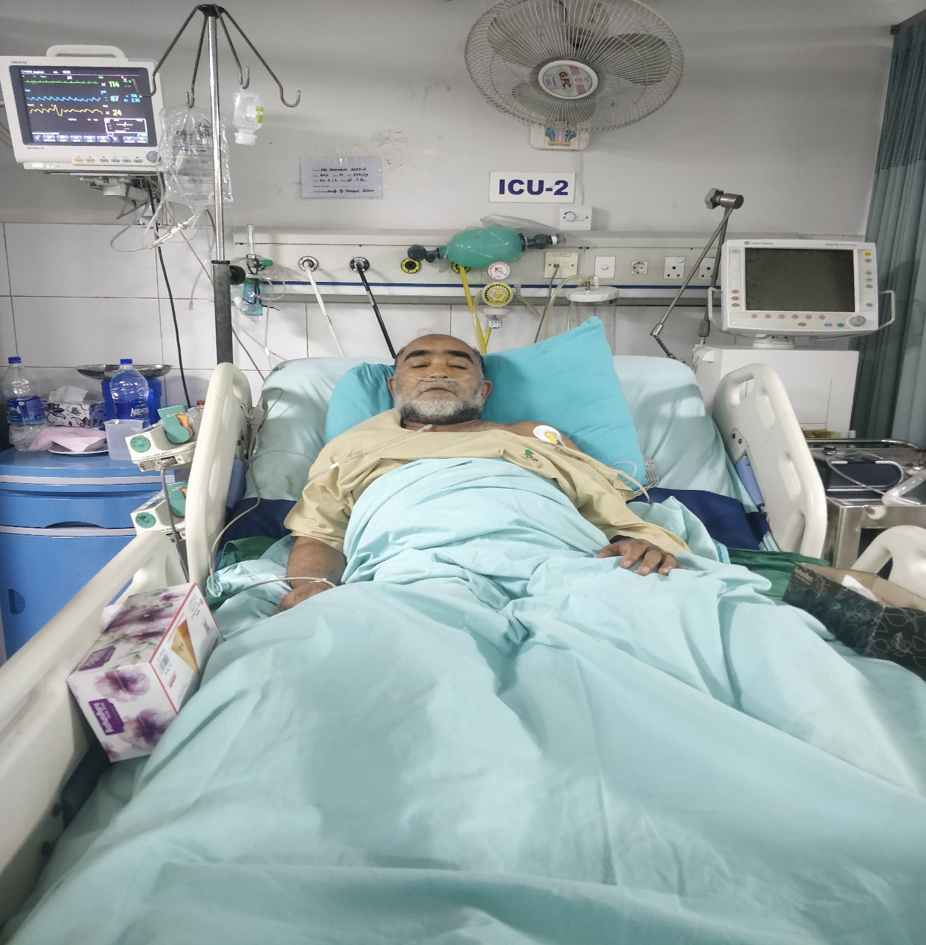
Common scenario in this year

Slide 42
Changing Pattern
Dengue fever and dengue hemorrhagic fever epidemiological changes:
The epidemiology of DF/DHF is complex and remains poorly understood. It involves host, viral and vector status that are further influenced by
demographic, economic, behavioral and varied societal factors

Slide 43
Changing Pattern
1. Changes in human host
  a. Shift in affected‑age group: Clinical DF in adults is rare. However, there is an evidence of increase of dengue incidence in older age groups, and this age shift has been reported in Singapore, Indonesia, Bangladesh and Thailand
  b. Sex differences
  c. Rural expansion

Slide 44
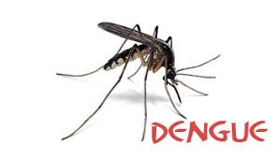
Changing Pattern
2. Changes in the dengue virus
  a. Virulence affecting severity of the disease
  Sequential infections or secondary infections are important to determine the severity of the disease
  The infection enhancement contributes to the pattern of variable‑sized outbreaks observed

Slide 45
Changing Pattern
b. Genotype affecting time interval between sequential infections
Studies in Thailand have revealed the following quantum of DHF risk with different sequences of dengue viruses with
DENV‑1/ DENV‑2: 500‑fold
DENV‑3/DENV‑2: 150‑fold
DENV‑4/DENV‑2 equals to 50‑fold risk

Slide 46
Changing Pattern
C. Changes In the vector bionomics
Rural spread
Seasonality and climate variability
Socio‑cultural and socio‑economic factors affecting vector longevity and survival

Slide 47
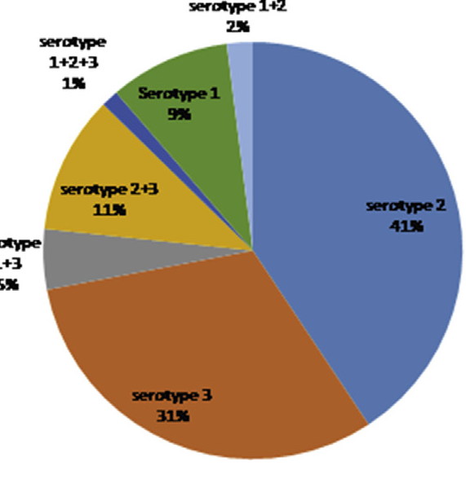
Largest dengue outbreak of the decade with high fatality may be due to reemergence of DEN-3 serotype in Dhaka, Bangladesh, necessitating immediate public health attention
T shirin et al , © 2019 The Author(s). Published by Elsevier Ltd, NMNI, 29, 100511
This is an open access article under the CC BY-NC-ND license (http://creativecommons.org/licenses/by-nc-nd/4.0/).

Slide 48
Dengue virus serotype 2 and 3 causing high morbidity and mortality in Swat, Pakistan
Hundreds of people died in the string of dengue epidemics in Pakistan since 2005.
In July 2013, a major outbreak of dengue started in Swat district of Khyber Pakhtunkhwa (KPK) which has so far caused 57 deaths and thousands of morbidities.
366 were found to be serologically positive by the Standard Diagnostics (SD) Dengue Duo test. All dengue virus (DENV)
positive samples were then analyzed using a DENV serotype-specific ( RT- PCR)
DENV serotypes present and to figure out active infections. In this study, 28.69%
(105/366) of the serologically positive patients had active infection and DENV type 3 (DENV-3) was the most abundant serotype followed by DENV-2
Amjad Ali 1,2 Zeeshan Nasim 1, Rafi Ur Rehman 1, Farzana 1, Sajid Ali 3,Fazli Zahir 1,Aqib Iqbal 1, Ijaz Ali 1,4*, Abdul
Biohelikon: Immunity and Diseases , 2013, Vol 1, a6 Research

Slide 49
Last year Out break Observation - 2018
Less rash
Fever persists longer duration
More Leucopenia
High AST
Tourniquet test +ve early
Diarrhea
Pharyngeal congestion
Myocarditis

Slide 50
This year Out break Observation - 2019
Very less Rash .( more convalescent rash)
Fever persists longer duration ( > 5 days )
More Leucopenia ( as low as 1137/mm3)
High AST ( 6123 IU )
High Lipase level ( 7419 U/L )
Tourniquet test +ve early ( even during febrile period) but less common
Diarrhea ( Very common )
Abdominal pain ( Frequent)
Persisting vomiting

Slide 51
Special observations 2019
Regular laboratory finding:
Ascites ( before critical phase)
Pleural effusion (Invariably in right side)
Encephalopathy
Isolated cranial nerve palsy
Acute renal failure
Splenomegaly
Pneumonitis
Pancreatitis
Pharyngeal congestion
GBS like feature ( hypokalamia must be ruled out due to vomiting)

Slide 52
Usual / Typical clinical presentations in DF
Sudden onset of very high fever
Moderate to severe body ache
Back pain ( break bone disease )
Prostration/ Fatigue
Eye ball pain ( Retrobulbar )
Headache
Nausea
Rashes 3 types

Slide 53
Data from 150 Patients, 2019
Dengue Case Group
Group –A …………. 24.3% (37)
Group – B ………… 57.4 %(86)
Group– C ………… 18.3% (27)
3 cases were in decompensated shock,1 died, 2 recovered

Slide 54
Dengue Case Group (150 data)

Slide 55
Clinical Presentations ( Symptom/ Sign)
Fever not typical always
Rash (mostly convalescence) …. 29 (19.3%)
Pain abdomen……… 84 (56.7%)
Persisting vomiting ……. 60 (40%)
Loose motion ………. 96 (64%)
Bleeding (Any form)………. 30(20%)
Ascites ……………………….. 102(68%)
Itching ……………………… 42(28%)

Slide 56
Contd.
Pleural effusion ………. 101(66.67%)
Hepatomegaly …………… 72(48.2%)
Splenomegaly ……… 16(10.7%)
Jaundice …………….. 30(20%)
Pneumonia ………. 8 (5%)
Acute renal failure ………… 6(4%)
TT …………. 18(12%)

Slide 57
Investigations
Total count of WBC as low as 1120/ mm3
Lowest Platelet 4000/ mm3
Gall blader thickening/ cholecystitis …… 66(44.3%)
High Lipase (> 500) ………. 36 (23.7%)
High SGOT (> 200) ……………. 112(74.7%) 6531
IgG positive …………. 86(57.5%)

Slide 58
Dengue with Co-infection
Need more documentation
Need to find correlation –
1. Enteric Fever
2. Pneumonia
3. UTI
4. Infective diarrhea

Slide 59
Dengue with Splenomegaly
Need to consider-
Enteric Fever
HLH
Enteric Fever out of 16 Splenomegaly cases
3 culture positive

Slide 60
Changing Fever pattern : Onset of afebrile period

Slide 61
About HLH
Haemophagocytic lymphohistiocytosis (HLH) is rare but potentially fatal severe immune activation syndrome caused by proliferation of activated lymphocytes and macrophage which leads cytokine release syndrome

Slide 62
HLH (Diagnostic Criteria)
5 of the following eight findings:
Fever ≥38.5°C
Splenomegaly
Bicytopenia
Hypertriglyceridemia and/or hypofibrinogenemia
Hemophagocytosis in bone marrow, spleen, lymph node, or liver
Low or absent NK cell activity
Ferritin >500 ng/mL
Elevated soluble CD25
Among above, NK cell activity and CD 25 cell are almost always not available to measure, and often there is lack of evidence of hemophagocytosis in biopsy

Slide 63
HLH (Treatment)
High dose steroid
Immunoglobulin

Slide 64
HLH Experience !

Slide 65
HLH Experience
We have got 9 out of 16 patients having splenomegaly who fulfill the criteria of HLH and diagnosed as DF with HLH
Experience:
Longer duration of illness(Increase hospital stay)
Treating as usual protocol with high monitoring of vital signs
We used oral prednisolone.
No casualty occurred and all patients are now completely fine (Follow up revealed normal reports)

Slide 66
Excessive Menstrual Bleeding
Dengue Fever may cause early menstruation / prolongation of menstrual period
We get better outcome with hormonal therapy

Slide 67
About NS1
False positive ------- 5%
False negative---- 5%
So, need more emphasis on clinical presentation
We got 23 ( 15%) dengue patients (NS1 negative)

Slide 68
Blood transfusion
No need of Blood transfusion
Blood for blood loss
May consider in case of –
Excessive visible bleeding
Rapid fall of HCT

Slide 69
About Fluid Management
When Fluid needs rapid correction :
Impending Shock / Shock
High HCT
Narrow pulse pressure (<20)

Slide 70
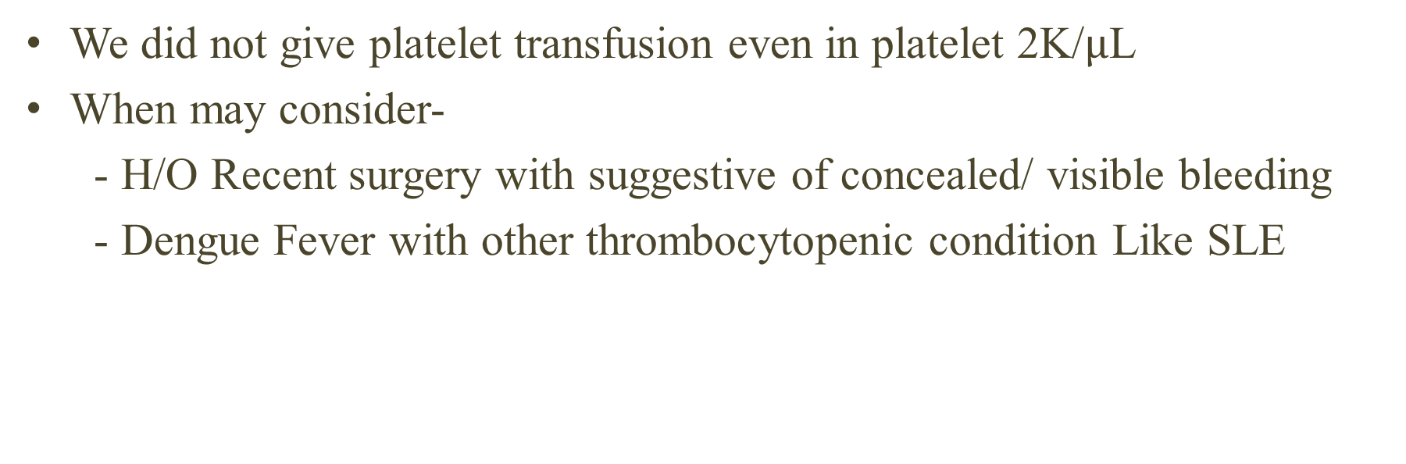
Platelet transfusion
We did not give platelet transfusion even in platelet 2K/$µ$L
When may consider-
- H/O Recent surgery with suggestive of concealed/ visible bleeding
- Dengue Fever with other thrombocytopenic condition Like SLE

Slide 71
Management highlights
Out of 150 patients
3 patients got Apheretic platelet transfusion
3 patients got whole blood transfusion (menorrhegia 2, GI bleeding 1)
Colloid Infusion – 15 cases ( 10% )
90% management with Crystaloid fluid
1/3rd of patients were managed poor before admission or delayed report to hospital

Slide 72
Prognosis
Early development of Leucopenia progress to plasma leakage more rapidly and may have a worst course
HCT > 48 needs urgent fluid management
HCT <30 needs to check internal bleeding
Ig G positive patient may need special consideration
Dengue fever with leukocytosis need to consider pancreatitis/pneumonia
Development of Itching suggests recovery

Slide 73
Alarming for Future
Sensitivity of NS1
Prolonged Loose motions (may lead to irreversible shock)
Acute renal failure
Co-infection
HLH
Plasma leakage even without fever

Slide 74
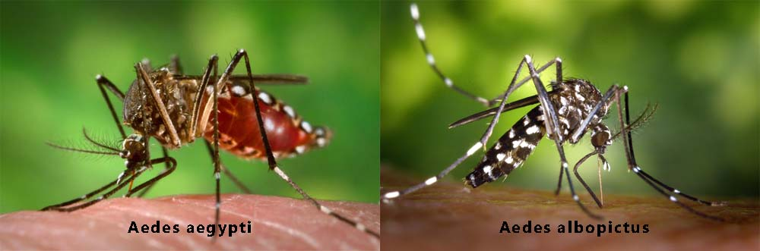

Slide 75
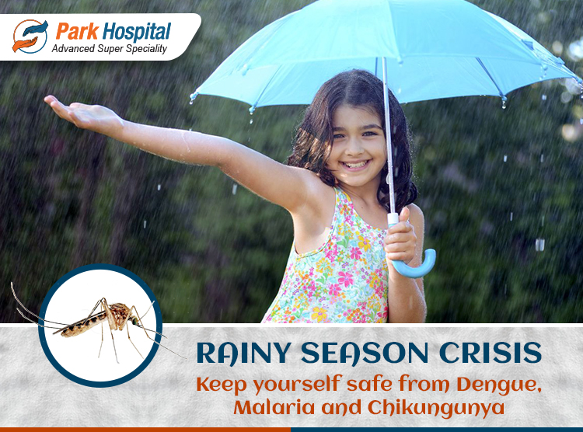

Slide 76

Thank You

